Slide 1
Facial recognition door lock using Deep learning

Slide 2
CONTENTS
1
Used algorithm in project
2
Improvements for 3D Face Recognition
3
3D modeling by solidworks
4
Demonstration video of the final result

Slide 3
Used algorithm in project

Slide 4
01
Used algorithm in project
1. Haar cascade algorithm
- Used to detect objects in video or images based on their features
- Algorithm operation sequence
1. Haar feature selection
2. Creating integral images
3. Adaboost Training
4. Cascading Classifiers

Slide 5

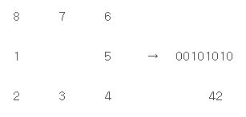
01
Used algorithm in project
2. LBPH algorithm

Slide 6
01
Used algorithm in project
Feedback
∙ Need to increase the accuracy
∙ Need to distinguish a photo from real face
->Using another algorithm

Slide 7
Improvements for 3D Face Recognition

Slide 8
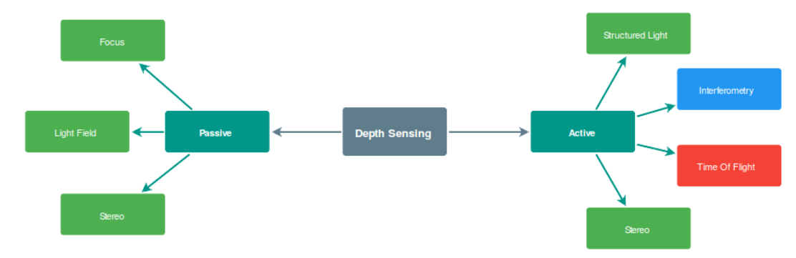
03
Improvements for 3D Face Recognition
- Depth sensing

Slide 9
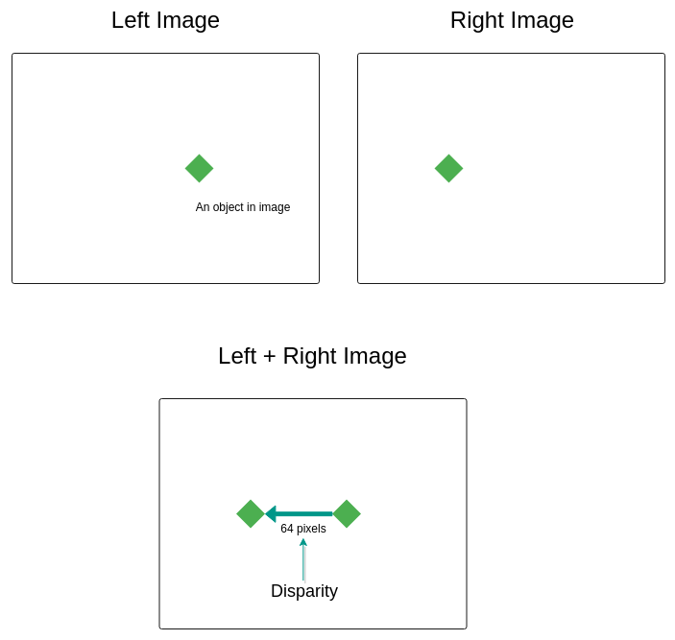
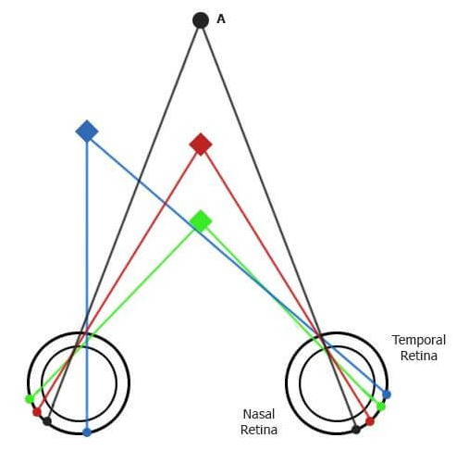
03
Improvements for 3D Face Recognition
- Stereo type

Slide 10
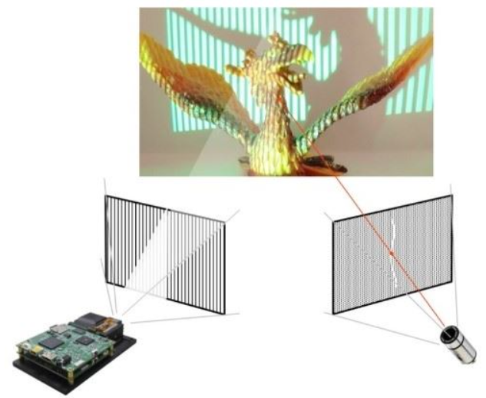
03
Improvements for 3D Face Recognition
- Structured Pattern type

Slide 11
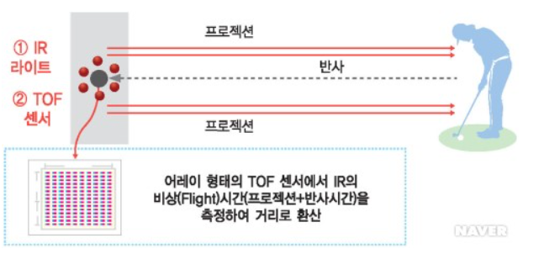
03
Improvements for 3D Face Recognition
- TOF(Time of Flight)

Slide 12
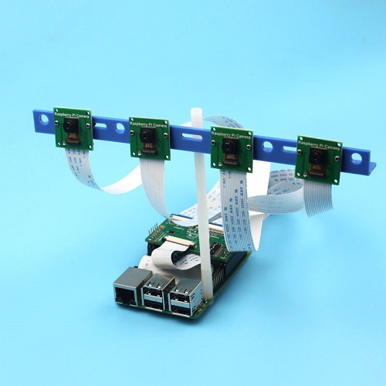
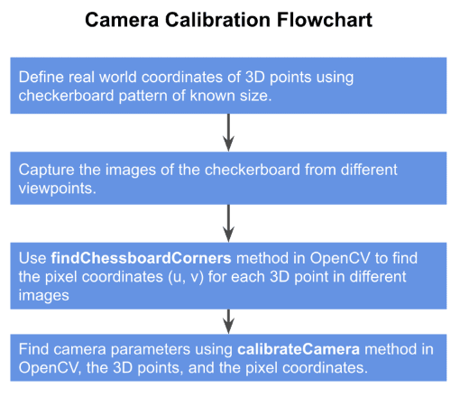
03
Improvements for 3D Face Recognition
- Camera calibration method using multiple pi camera

Slide 13
3D modeling by solidworks

Slide 14
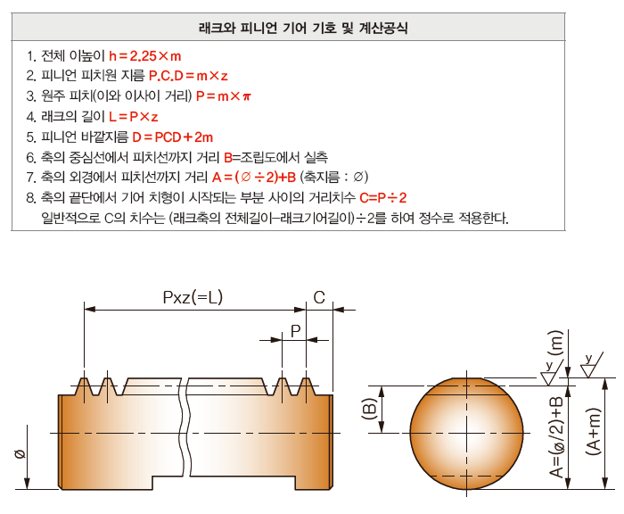
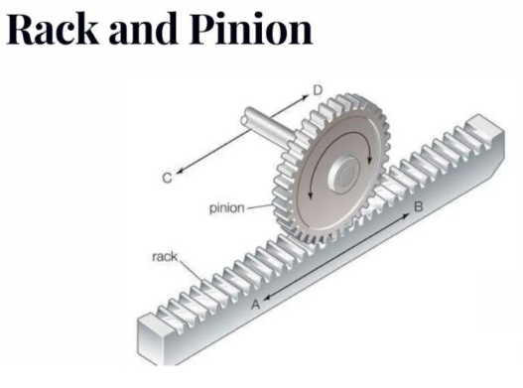
02
3D modeling by solidworks
1. Pinion and rack

Slide 15
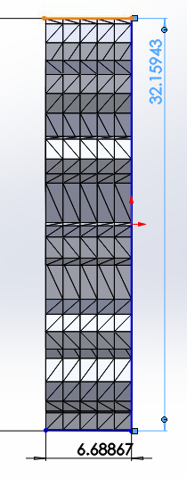
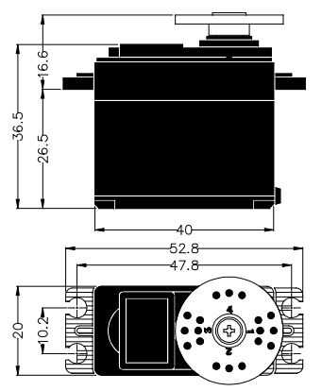
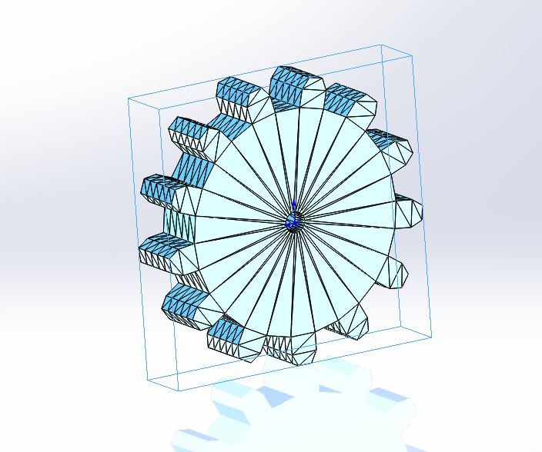
02
3D modeling by solidworks
1. Pinion and rack

Slide 16
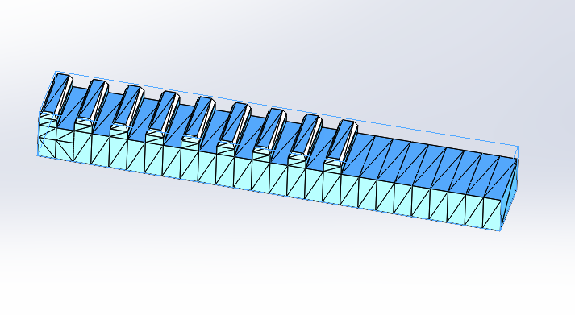
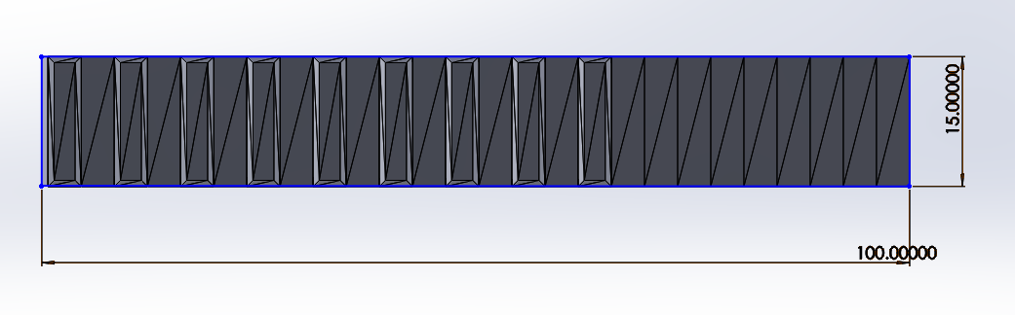
02
3D modeling by solidworks
1. Pinion and rack

Slide 17
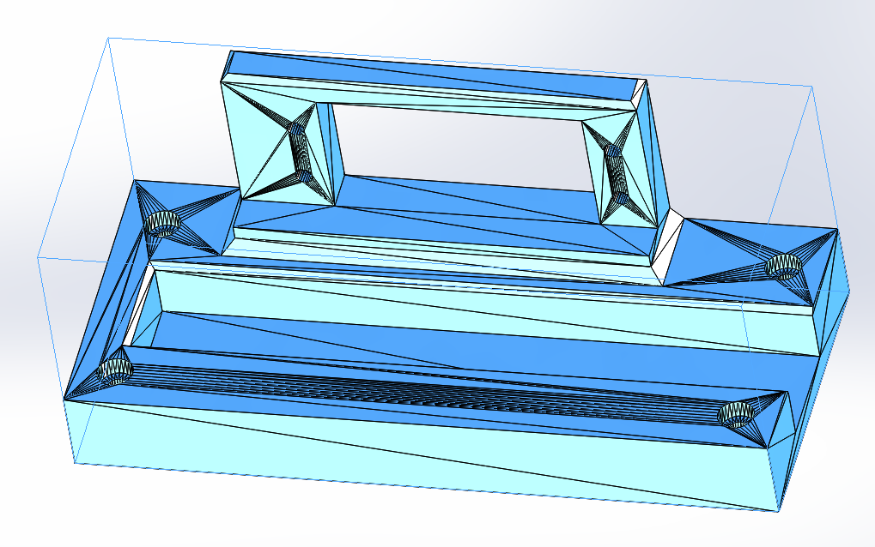


02
3D modeling by solidworks
2. Door lock body
- 1 : Motor fixing part 2 : Groove for pinion rack

Slide 18
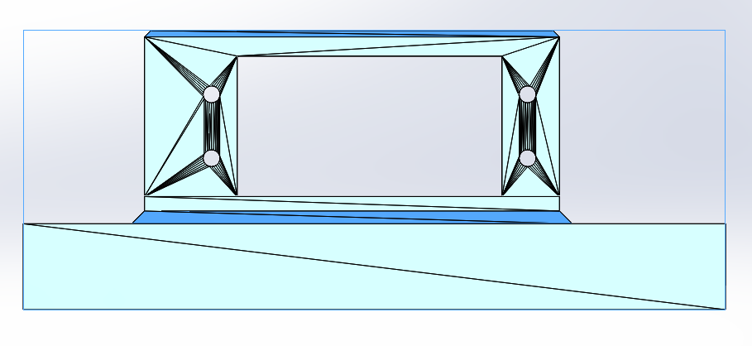
02
3D modeling by solidworks
2. Door lock body (Motor holder)
Motor holder part

Slide 19
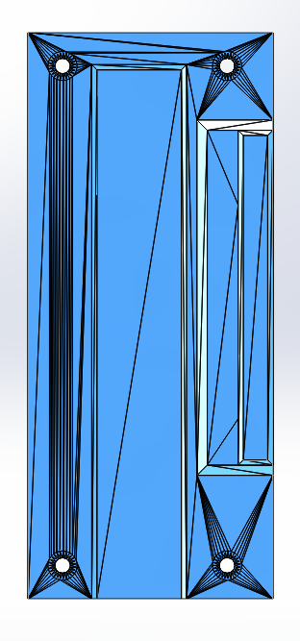
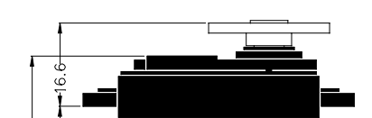
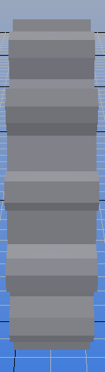
02
3D modeling by solidworks
2. Door lock body (Pinion rack part)

Slide 20
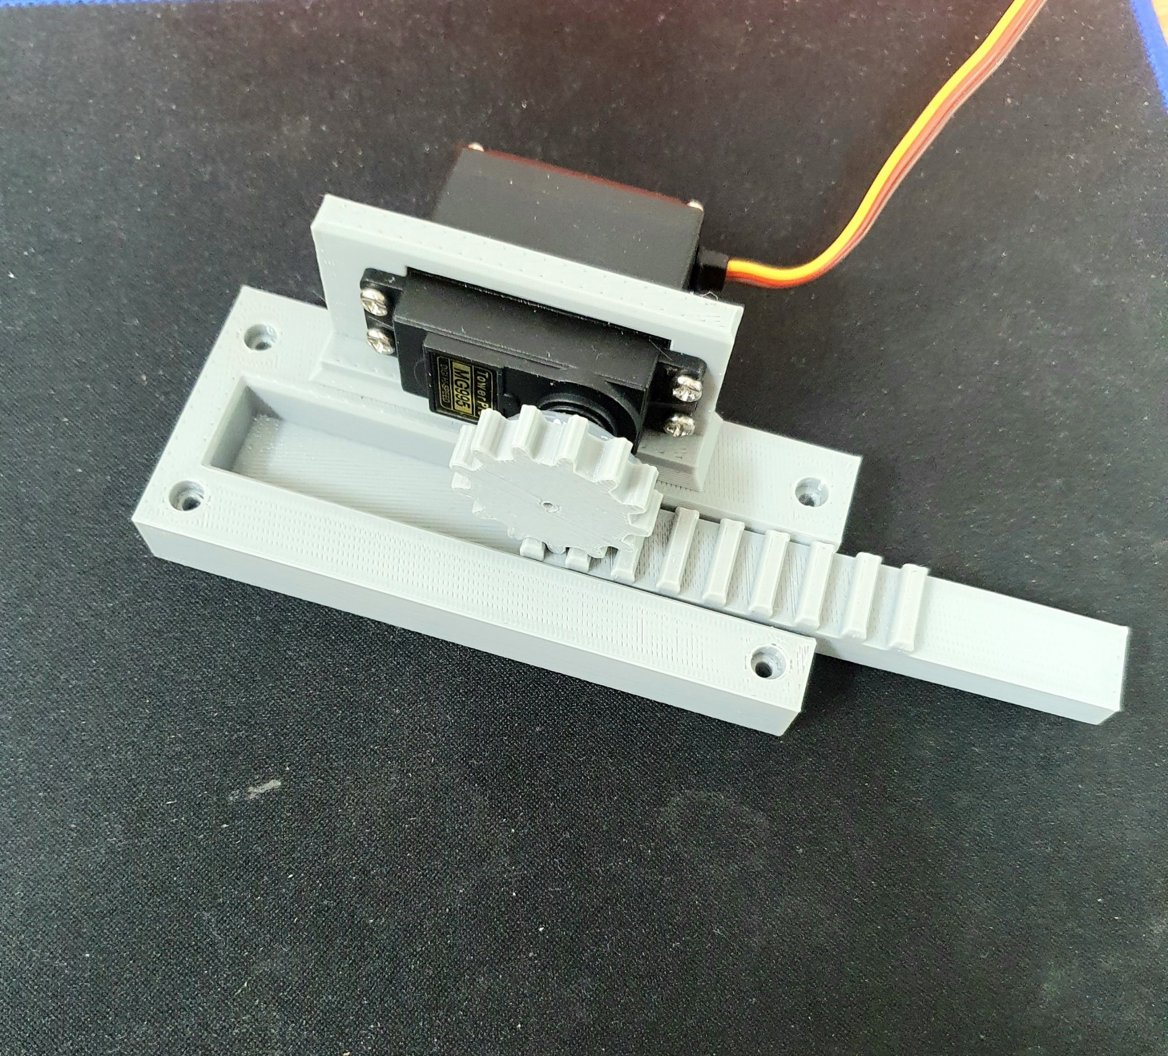
02
3D modeling by solidworks
3. Finished door lock model

Slide 21
Demonstration video of the final result

Slide 22
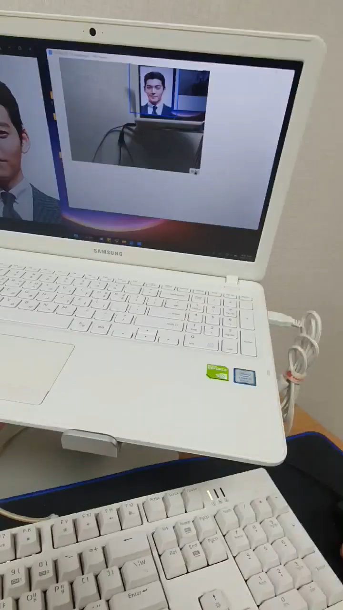
04
Demonstration video of the final result

